Slide 1
System Testing
Notes de cours recueilli Par Wahid Bannour

Slide 2
Definition
System Testing is a level of testing that validates the complete and fully integrated software product. The purpose of a system test is to evaluate the end-to-end system specifications. Usually, the software is only one element of a larger computer-based system. Ultimately, the software is interfaced with other software/hardware systems. System Testing is defined as a series of different tests whose sole purpose is to exercise the full computer-based system.

Slide 3
System Testing is Blackbox
Two Category of Software Testing
Black Box Testing
White Box Testing
System test falls under the black box testing category of software testing.
White box testing is the testing of the internal workings or code of a software application. In contrast, black box or System Testing is the opposite. System test involves the external workings of the software from the user’s perspective.

Slide 4
What do you verify in System Testing?
System Testing involves testing the software code for following
Testing the fully integrated applications including external peripherals in order to check how components interact with one another and with the system as a whole. This is also called End to End testing scenario.
Verify thorough testing of every input in the application to check for desired outputs.
Testing of the user’s experience with the application.
That is a very basic description of what is involved in system testing. You need to build detailed test cases and test suites that test each aspect of the application as seen from the outside without looking at the actual source code.

Slide 5
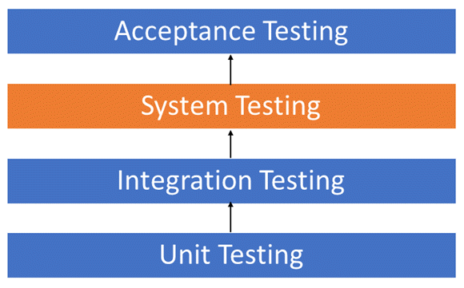
Software Testing Hierarchy
As with almost any software engineering process, software testing has a prescribed order in which things should be done. The following is a list of software testing categories arranged in chronological order. These are the steps taken to fully test new software in preparation for marketing it:
Unit testing performed on each module or block of code during development. Unit Testing is normally done by the programmer who writes the code.
Integration testing done before, during and after integration of a new module into the main software package. This involves testing of each individual code module. One piece of software can contain several modules which are often created by several different programmers. It is crucial to test each module’s effect on the entire program model.
System testing done by a professional testing agent on the completed software product before it is introduced to the market.
Acceptance testing – beta testing of the product done by the actual end users.

Slide 6
Types of System Testing
There are more than 50 types of System Testing.
Below we have listed types of system testing a large software development company would typically use
Usability Testing – mainly focuses on the user’s ease to use the application, flexibility in handling controls and ability of the system to meet its objectives
Load Testing – is necessary to know that a software solution will perform under real-life loads.
Regression Testing – involves testing done to make sure none of the changes made over the course of the development process have caused new bugs. It also makes sure no old bugs appear from the addition of new software modules over time.

Slide 7
Types of System Testing (2)
Recovery Testing – is done to demonstrate a software solution is reliable, trustworthy and can successfully recoup from possible crashes.
Migration Testing – is done to ensure that the software can be moved from older system infrastructures to current system infrastructures without any issues.
Functional Testing – Also known as functional completeness testing, Functional Testing involves trying to think of any possible missing functions. Testers might make a list of additional functionalities that a product could have to improve it during functional testing.
Hardware/Software Testing – IBM refers to Hardware/Software testing as “HW/SW Testing”. This is when the tester focuses his/her attention on the interactions between the hardware and software during system testing.

Slide 8
What Types of System Testing Should Testers Use?
There are over 50 different types of system testing. The specific types used by a tester depend on several variables. Those variables include:
Who the tester works for – This is a major factor in determining the types of system testing a tester will use. Methods used by large companies are different than that used by medium and small companies.
Time available for testing – Ultimately, all 50 testing types could be used. Time is often what limits us to using only the types that are most relevant for the software project.
Resources available to the tester – Of course some testers will not have the necessary resources to conduct a testing type. For example, if you are a tester working for a large software development firm, you are likely to have expensive automated testing software not available to others.
Software Tester’s Education- There is a certain learning curve for each type of software testing available. To use some of the software involved, a tester has to learn how to use it.
Testing Budget – Money becomes a factor not just for smaller companies and individual software developers but large companies as well.

